Slide 1

Data Analyst Program - Interim Project Analyst Program - Interim Project
GROUP 5Analyst Program - Interim Project
Kip Lemos
Tetiana
Stephen
Isaac Nagre
Sherifat Odutolu
Analyst Program - Interim Project

Slide 2
Introduction
This interim project comprises solution to the six questions about Adventure Works
SQL, Python are use to answer the questions

Slide 3
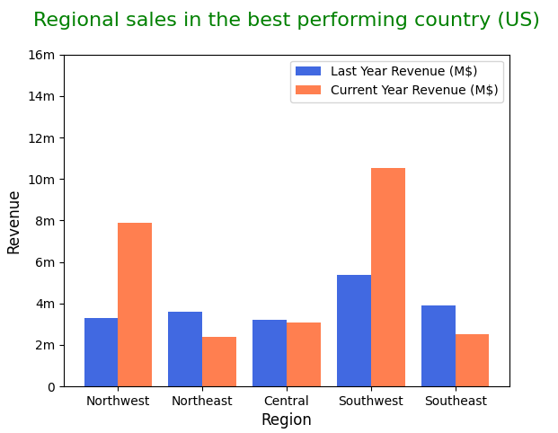
1 - What are the regional sales in the best performing country?

Slide 4
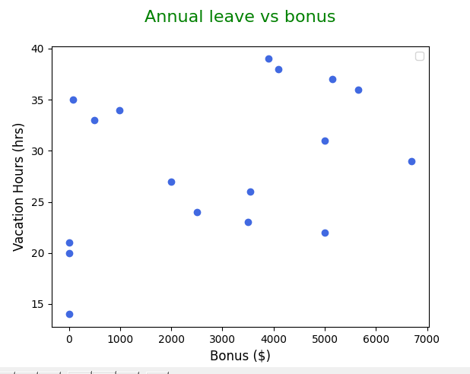
2 - What is the relationship between annual leave taken and bonus?

Slide 5
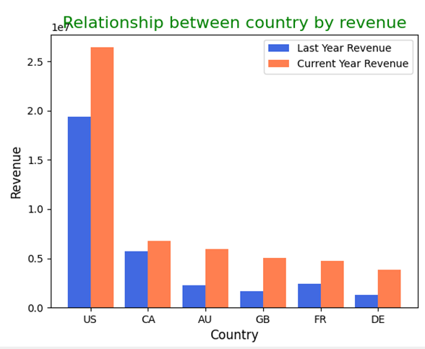
3 - What is the relationship between Country and Revenue?

Slide 6
4 - What is the relationship between sick leave and Job Title (PersonType)?

Slide 7
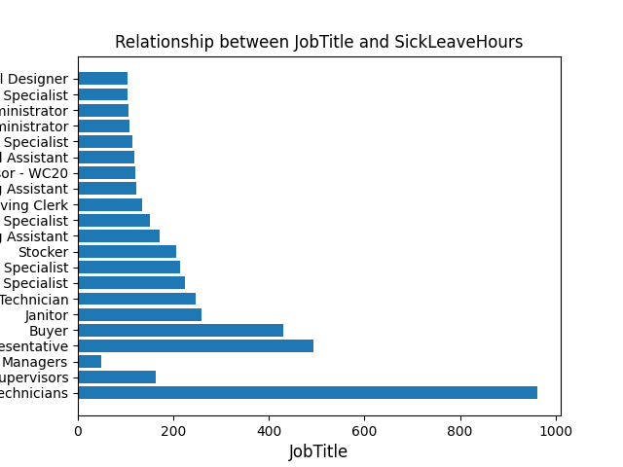

Slide 8
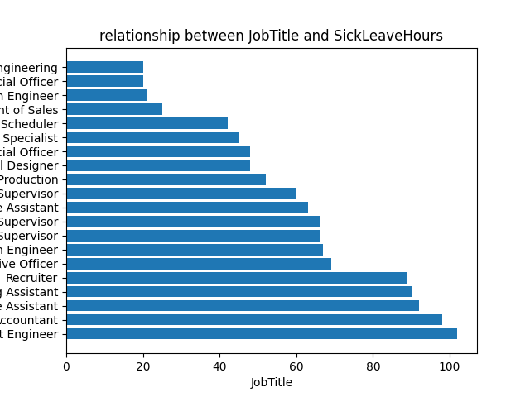

Slide 9
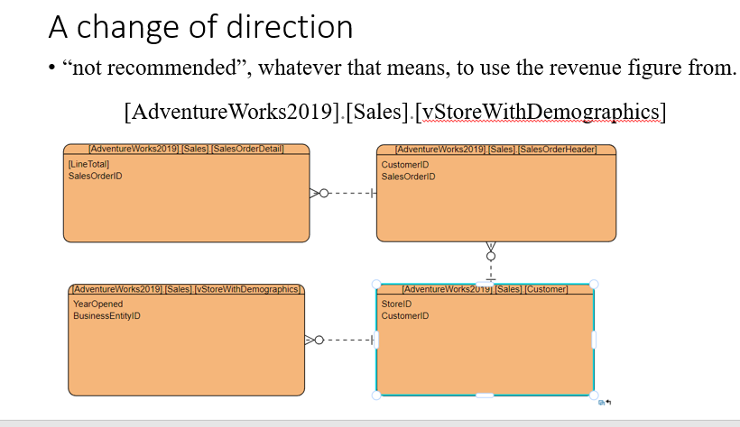
5 -What is the relationship between store trading duration and revenue?

Slide 10
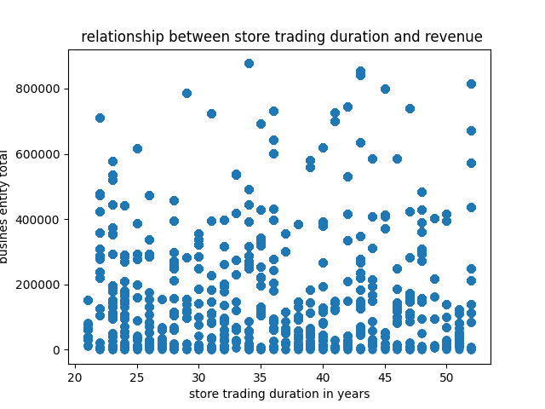

Slide 11
6 - What is the relationship between the size of the stores, number of employees and revenue?
Store Type | Size ft² | Employee Number
Small | < 15000 | <15
Medium | 15000 – 30000 | 15-30
Large | 30000 – 50000 | 30-60
Mega | 30000 – 50000 | >60

Slide 12
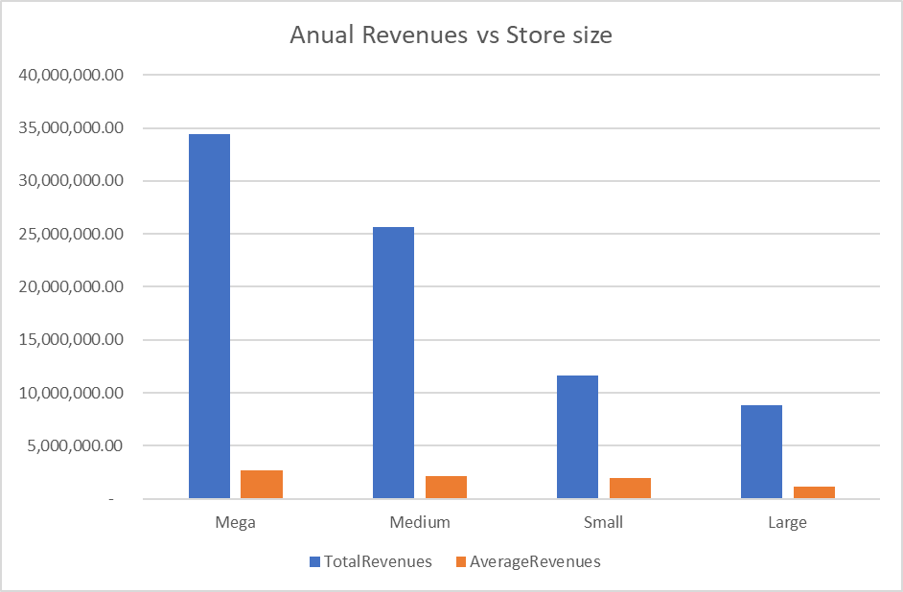

Slide 13
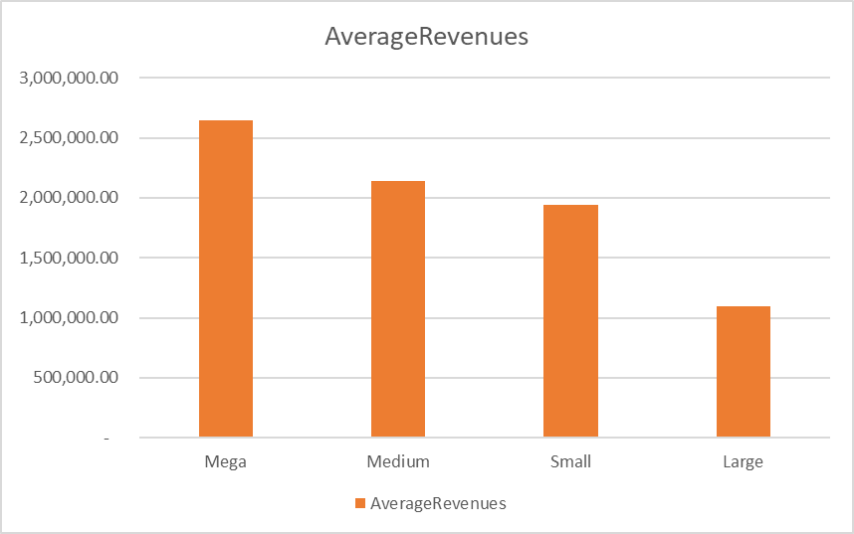

Slide 14
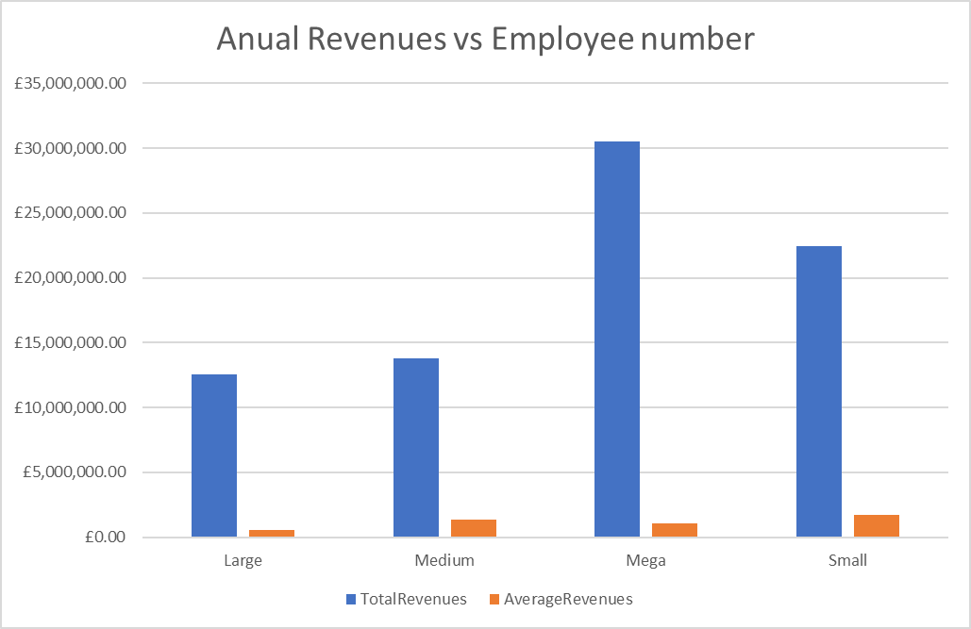

Slide 16
Question?
Thank you.

